Slide 1
Mini Popper | Colt poppers | Pepper poppers | Plates | Wall feet
5 | 5 | 0 | 0 | 62
Bay | Stage | Target Type | Count | NS | Total | Hard Cover
SH | Made Up | IPSC | 8 |  | 8
A3 | Step to it | USPSA | 12 |  | 12
B1 | Pepe le pew | IPSC | 10 | 3 | 13 | 2 Right Diag
B2 | Deviled Eggs | USPSA | 10 | 2 | 12 | 1 Tux 1 Left Diag
B3 | Hands ON | IPSC | 7 | 1 | 8 | 1 Left Diag 1 Right Diag
B4 | CM 20-02 | USPSA | 6 | 3 | 9

Slide 2
Prop | Stage

Slide 3

 | Dothan Practical Shooters – USPSA Match Made Up Course Designer : Drew Coleman Bay: Shoot House
Round Count 26 rounds 8 IPSC 2 mini poppers
Equipment List Just make it up

Slide 4
Made Up
Written Stage Briefing
Scoring: Comstock Rounds: 26
Targets: 8 IPSC, 2 steel
Best 3 per paper
Handgun start position: hands touching marks. Handgun is loaded and holstered.
PCC start position: muzzle touching either mark. Loaded carbine is held with both hands.
Stage Procedure: On the audible start signal, engage targets as they become available from within the shooting area.

Slide 5
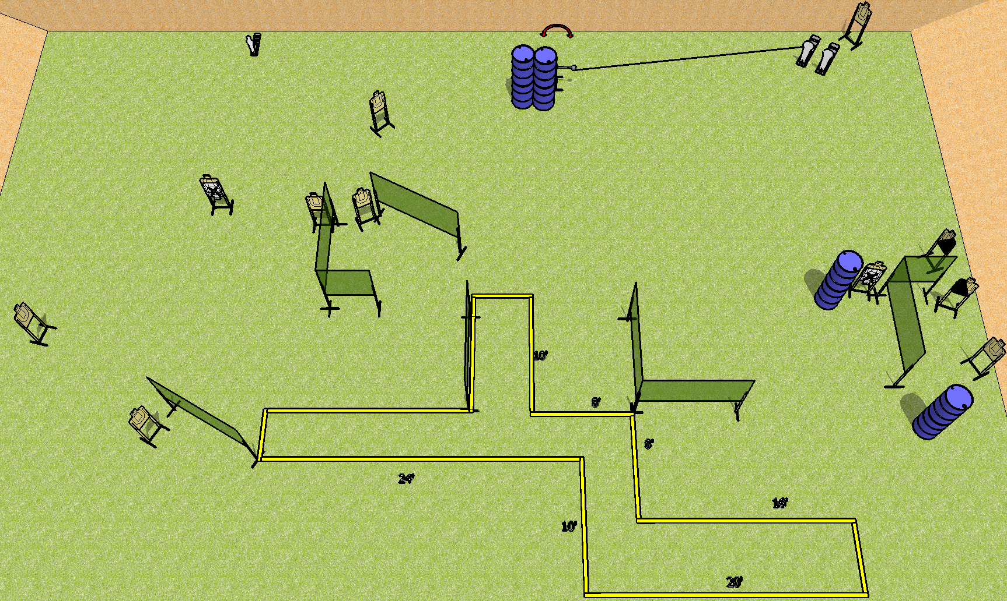
 | Dothan Practical Shooters – USPSA Match Step to it Course Designer : Drew Coleman Bay: A3
Round Count 27 rounds 12 USPSA 2 colt poppers, 1 mini popper
Equipment List 15 wall feet Swinger + activator 12 targets (10 + 2NS) 1 left + 1 right diag

Slide 6
Step to it
Written Stage Briefing
Scoring: Comstock Rounds: 27
Targets: 12 USPSA, 3 steel
Handgun start position: anywhere completely outside the shooting area, wrists below belt. Handgun is loaded and holstered.
PCC start position: anywhere completely outside the shooting area, stock on belt. Loaded carbine is held with both hands, safety on.
Stage Procedure: On the audible start signal, engage targets as they become available from within the shooting area. The swinger is activated by P2 and remains visible at rest.

Slide 7
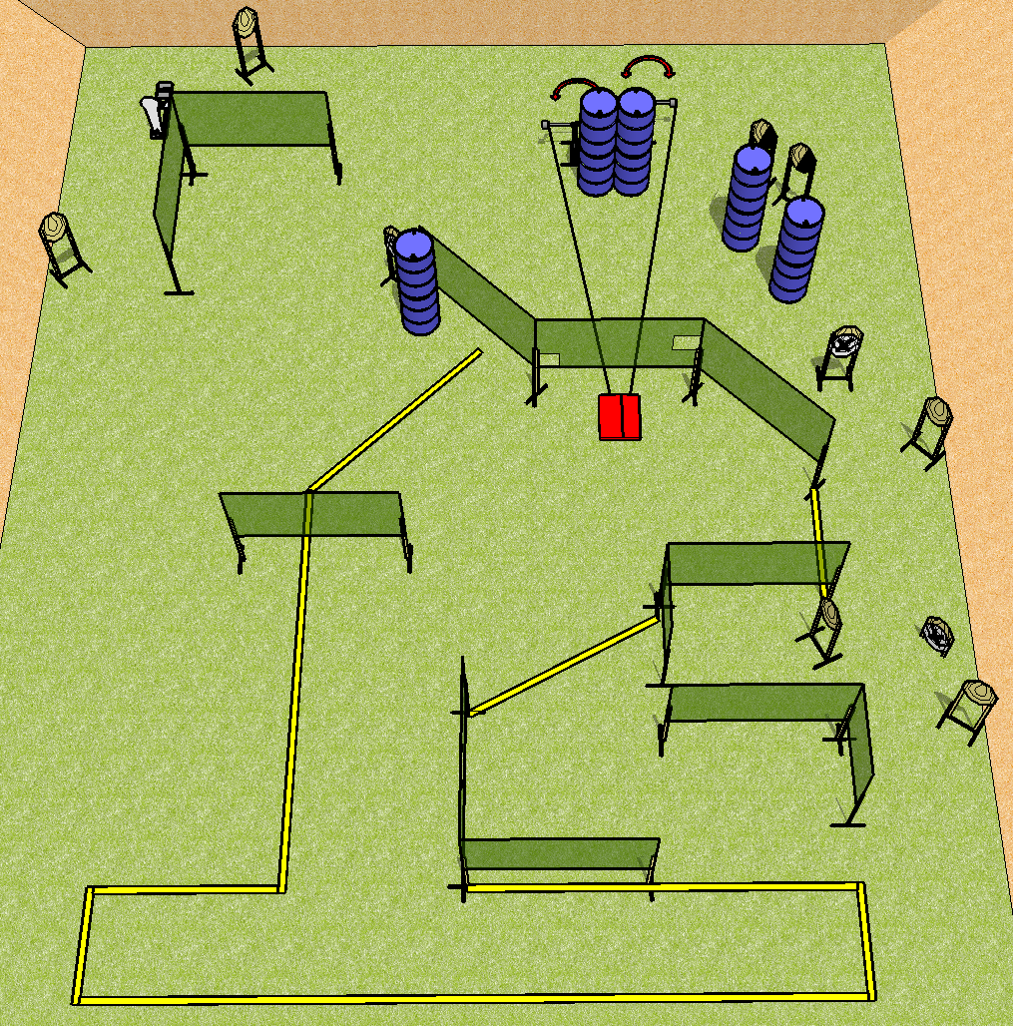
 | Dothan Practical Shooters – USPSA Match Pepe le Pew Course Designer : Drew Coleman Bay: B1
Round Count 25 rounds 12 IPSC 1 colt popper
Equipment List 20 wall feet, Stomp pad 2 swingers 13 targets (10 + 3 NS) 2 right diag

Slide 8
Pepe le Pew
Written Stage Briefing
Scoring: Comstock Rounds: 25
Targets: 12 IPSC, 1 steel
Handgun start position: feet on X’s, wrists below belt. Handgun is loaded and holstered.
PCC start position: feet on X’s, stock on belt. Loaded carbine is held with both hands, safety on.
Stage Procedure: on the audible start signal, engage targets as they become available from within the shooting area. The swingers are activated by the stomp pad and remain visible at rest. The stomp pad is part of the shooting area.

Slide 9
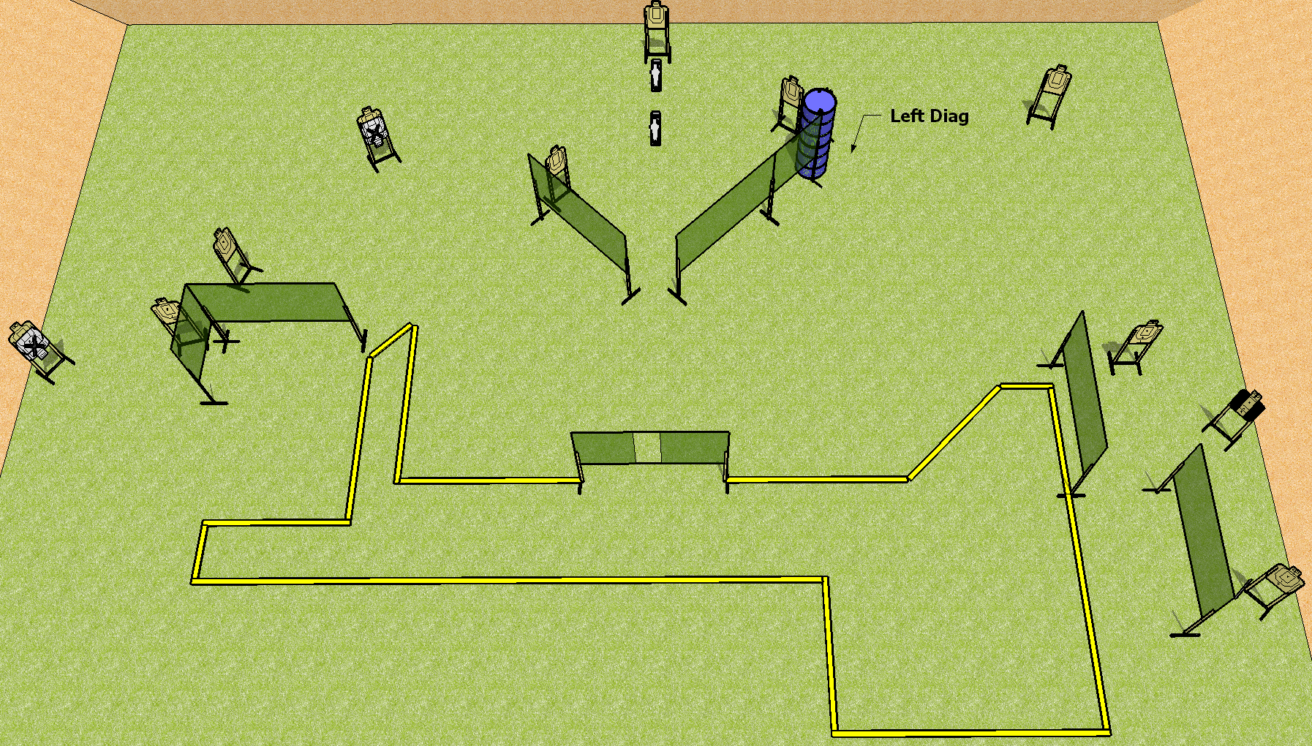
 | Dothan Practical Shooters – USPSA Match Deviled Eggs Course Designer : Drew Coleman Bay: B2
Round Count 26 rounds 12 USPSA 2 mini poppers
Equipment List 14 wall feet 12 targets (10 + 2NS) 1 left diag, 1 tux

Slide 10
Deviled Eggs
Written Stage Briefing
Scoring: Comstock Rounds: 26
Targets: 12 USPSA, 2 steel
Handgun start position: anywhere inside the shooting area, wrists below belt. Handgun is loaded and holstered.
PCC start position: anywhere inside the shooting area, stock on belt. Loaded carbine is held with both hands, safety on.
Stage Procedure: on the audible start signal, engage targets as they become available from within the shooting area.

Slide 11
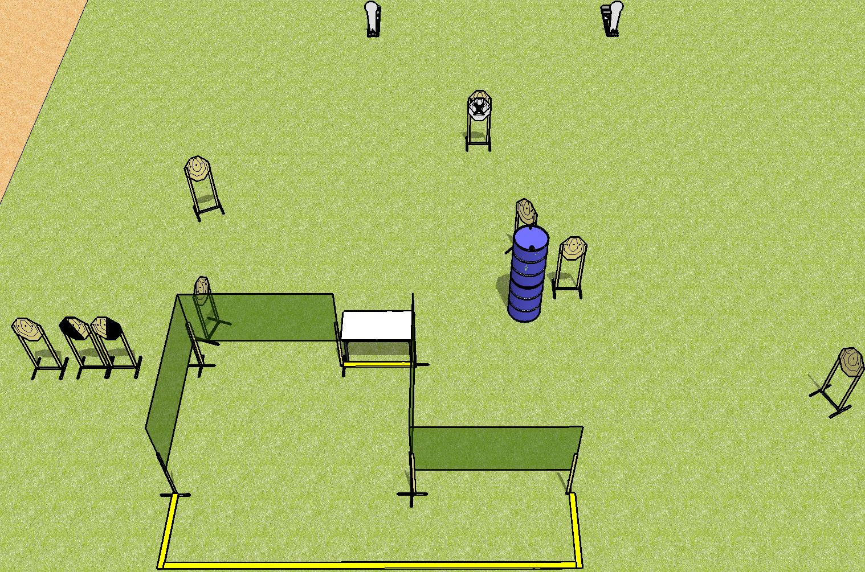
 | Dothan Practical Shooters – USPSA Match Hands On Course Designer : Drew Coleman Bay: B3
Round Count 20 rounds 9 IPSC 2 colt poppers
Equipment List 6 wall feet 8 targets (7 + 1NS) 1 left + 1 right diag

Slide 12
Hands On
Written Stage Briefing
Scoring: Comstock Rounds: 20
Targets: 9 IPSC, 2 steel
Start position: both hands fingers touching walls on either side of table. Firearm is on table, trigger guard on mark, loaded.
Stage Procedure: on the audible start signal, engage targets as they become available from within the shooting area.

